Slide 1

GGP Week 6

Slide 2
Recap: MCTS
Implementation variations
Expand: One new child/grandchild vs. all children/grandchildren
Node representation (for multi-player): separate min/max nodes vs. meta-nodes
Select: minimax vs. maximax (for cooperative games)
Optimizations
IsFullyExplored flag
New Select function
Multiple heuristics
Anything else?
Testing
How did you test MCTS performance?
How many Connect 4 depth charges per second?

Slide 3
StateMachine Tinkering
Why: Performance etc.

Slide 4
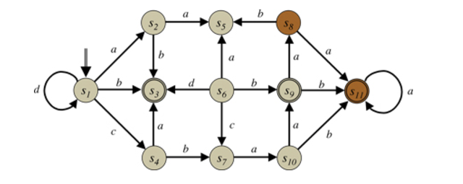
State View of the Game

Slide 5
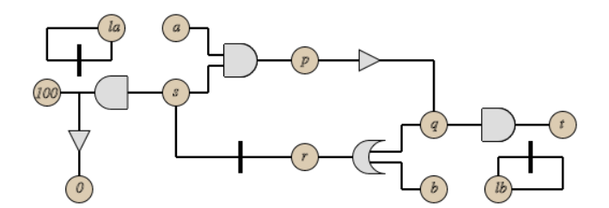
PropNet View of the Game

Slide 6
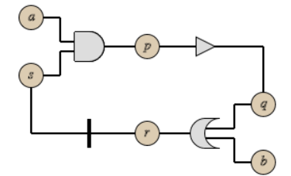
What is a PropNet, you ask?

Slide 7
What is a PropNet, you ask?
AND Gate
INVERT gate
TRANSITION gate
OR gate

Slide 8
What is a PropNet, you ask?
Input Proposition
View Propositions
Base Proposition
Input Proposition

Slide 9
What is a PropNet, you ask?
INIT
true

Slide 10
What is a PropNet, you ask?
INPUT
true
true
false

Slide 11
What is a PropNet, you ask?
Propagation
true
true
true
false

Slide 12
What is a PropNet, you ask?
Propagation
true
true
false
true
false

Slide 13
What is a PropNet, you ask?
Propagation
true
true
false
true
false
false

Slide 14
What is a PropNet, you ask?
Transition
true
false
false
false

Slide 15
How does this relate to a game?
Or game description?

Slide 16
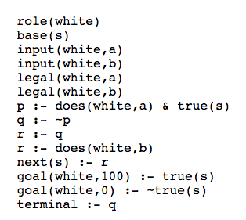
Let’s do an example

Slide 17
Let’s do an example
Base Proposition
S

Slide 18
Let’s do an example
Input Propositions
a
s
b

Slide 19
Let’s do an example
View Proposition
a
p
s
b

Slide 20
Let’s do an example
View Proposition
a
p
s
q
b

Slide 21
Let’s do an example
a
p
s
q
r
View Proposition
b

Slide 22
Let’s do an example
a
p
s
q
r
b
Transition

Slide 23
Let’s do an example
a
p
s
q
t
r
b
Terminal

Slide 24
Let’s do an example
There will be more nodes for legal and goal!!
a
p
s
q
t
r
b

Slide 25
What will you need to do?
Implement the essential state machine functions like:
isTerminal
getGoal
getInitialState
getLegalMoves
getNextState

